Slide 1

Youths involvement in Achieving SDG 13; Climate Action and Sustainable Development in Greater Eastern Uganda RCE
3rd African Youth Virtual Conference of the UNU RCEs organized by RCE Minna, Nigeria and RCE Grand Rapids, Michigan USA; November 13, 2019
Theme: “A Regional Perspective on the Role of RCEs in Achieving SDGs 13; Climate Action and Sustainable Development on the Continent.”
Presented by: Oyege Ivan
RCE youth coordinator

Slide 2
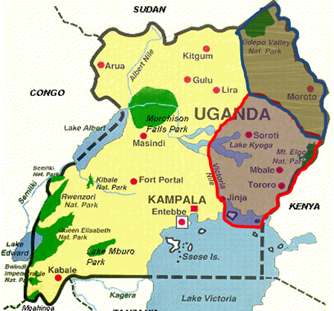
Location of Greater Eastern Uganda RCE
Greater Eastern Uganda RCE

Slide 3
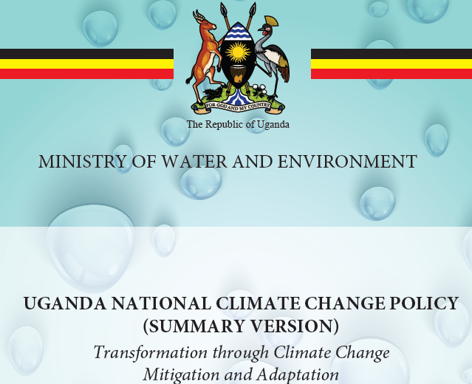
Uganda’s climatic change policy
Uganda’s National Development Plan II (2016-2021), vision 2040 and SDGs recognise climate change.
On April 1, 2015, a climatic change policy was approved by cabinet.
The policy ensures a harmonized and coordinated approach towards a climate-resilient and low-carbon development path for sustainable development in Uganda.
Uganda submitted Contributions to the UN Framework Convention on Climate Change in 2018.
It has Green Growth Strategy to meet the Bonn Challenge.
SDG 13.2 done; upscaling SDG 13.3

Slide 4
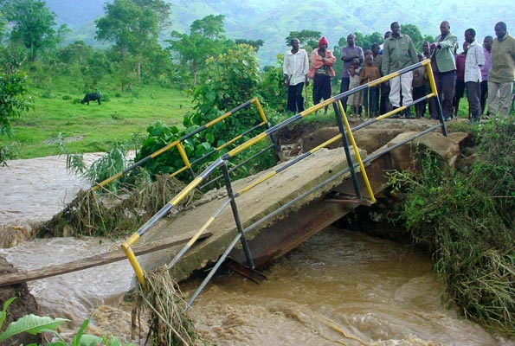
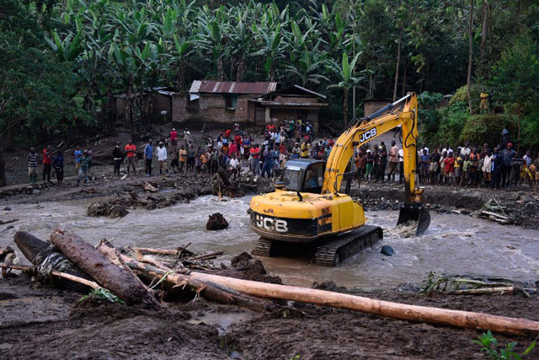
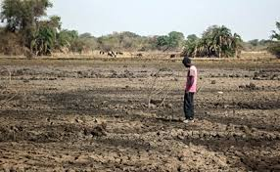
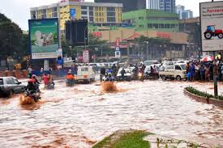
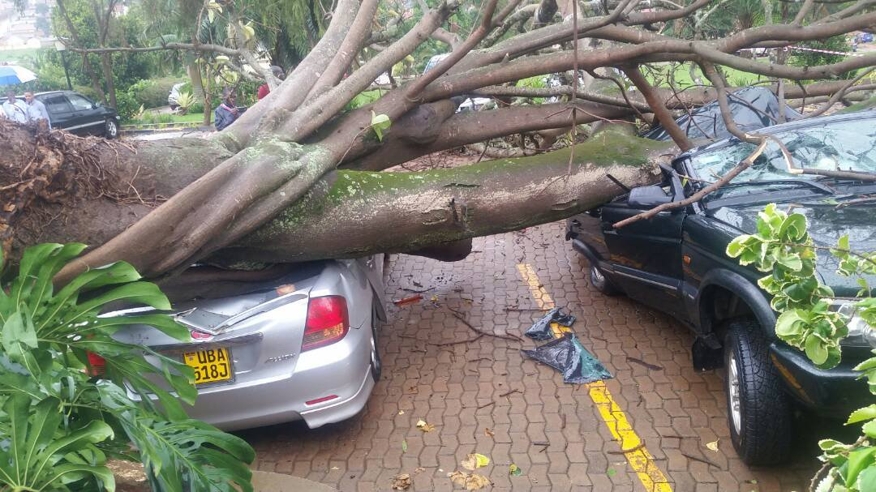

Climatic change in Uganda
2
1
3
4

Slide 5
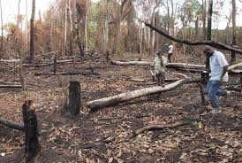
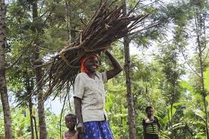
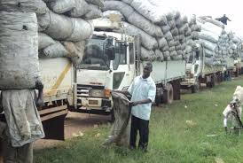
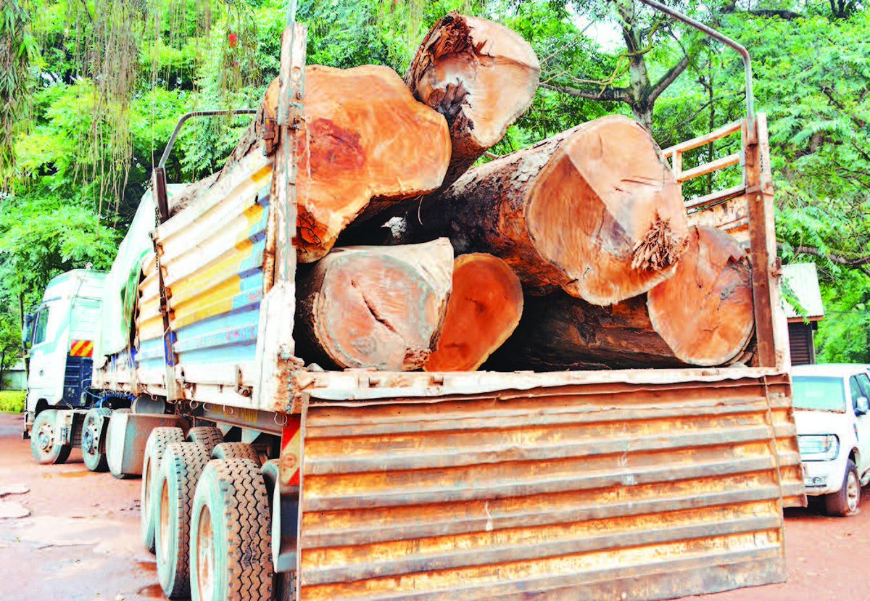
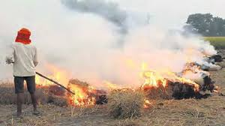
Human activities causing climatic change
1
2
3
4
5

Slide 6
Role of GEU RCE in achieving SDG 13.3
ESD is a taught cross cutting course in all programs offered in the University for all Certificate, Diploma, Bachelors, Masters and PhD courses.
The RCE is a branch of Nature Uganda; aimed at promoting the understanding, appreciation and conservation of Nature
The RCE is a member of the International Union of Conservation of Nature (IUCN)
The RCE supports all activities done by the youths in the RCE
Provides trees for planting and transport means to outreach places

Slide 7
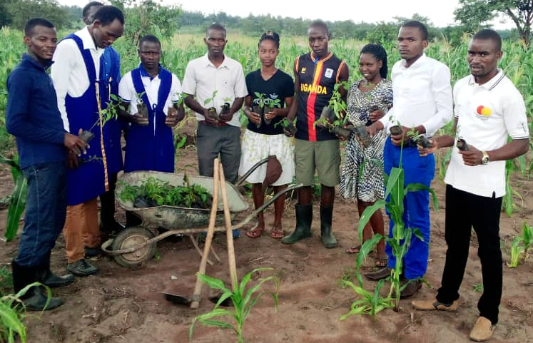
How the Youths of the RCE are involved in achieving SDG 13.3
They are organized in two
student championed and lead
associations.
1. Campus activities
  Tree growing
  Garbage management to avoid
  open burning of garbage
  Taking care of trees already
  planted
  Nature walks to conservation sites

Slide 8
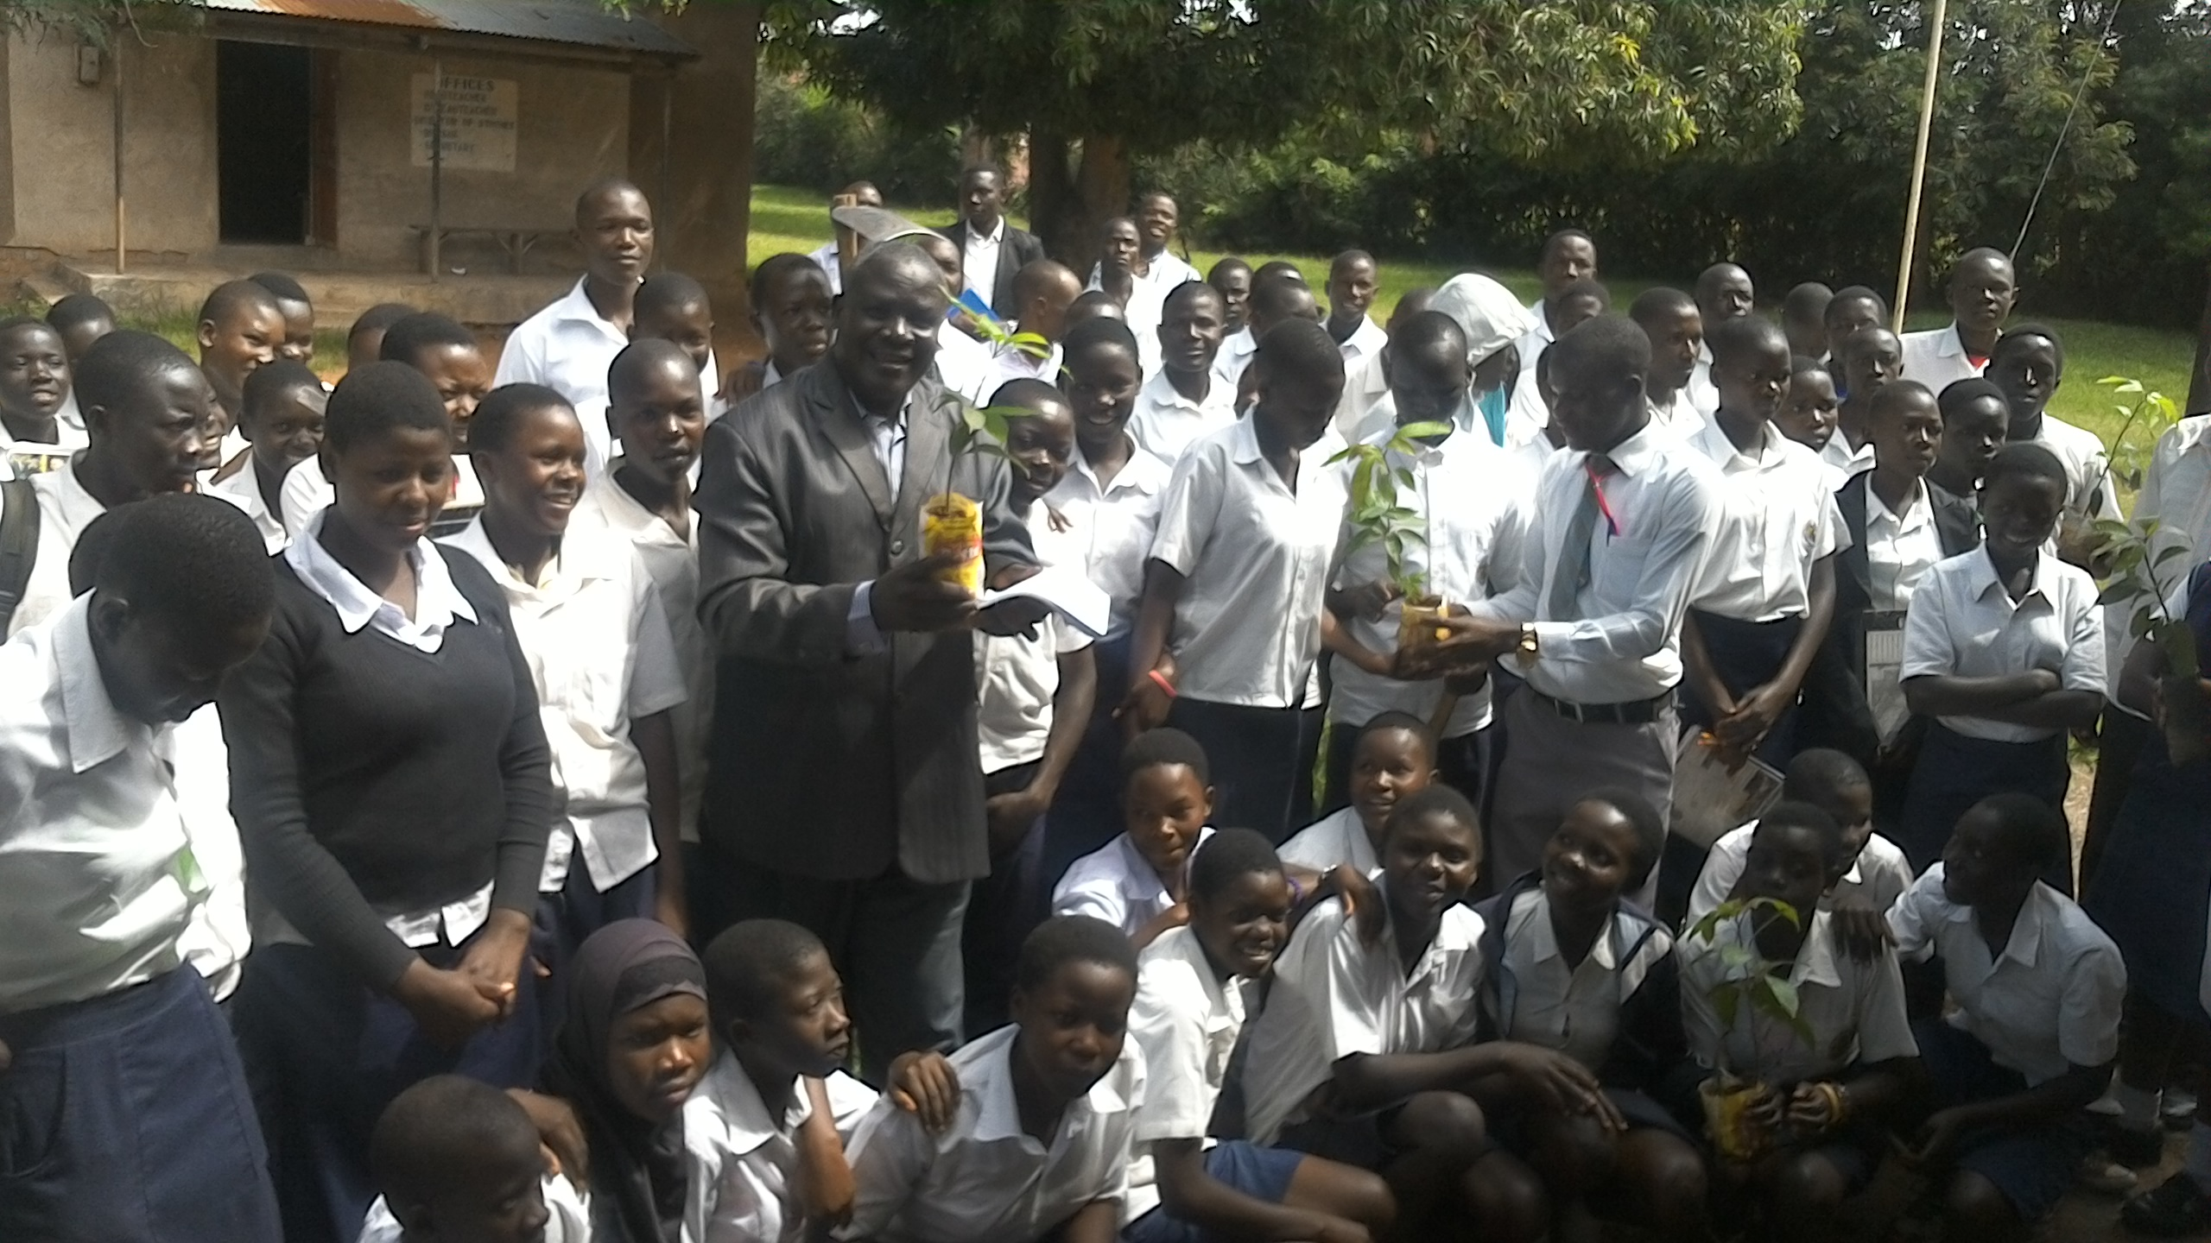
How the Youths of the RCE are involved in achieving SDG 13.3
2. Outreach activities
  Tree planting in the schools and communities
  Awareness raising and sensitization
  Establish environmental clubs lead by students to further sensitization
  Teach communities on conservation

Slide 9
Combating climatic change
The country program has not faired well due to underfunding.
Very good policies in place but no funds for execution.
Money needs to be allocated to mitigate the climatic change instead of acting after its effect.
Implementation needs to be upgraded.

Slide 10

Recommendations
Governments should allocate enough funds for achieving SDG 13
More frequent teaching of the people about climatic change and how it can be avoided.
Use modern and better agricultural methods
Reduction/Elimination of usage of biomass fuel and provide alternative sources of fuel.
  Reduce the cost of LPG
  Make electricity affordable
  Encourage use of biogas
  Adopt renewable sources of energy;
  solar energy, wind and atomic nuclear energy

Slide 11


Recommendations cont’d…
Strict laws on emission by industries and cars
Provide jobs for the youths
Improve public transport network to reduce on the number of personal cars which cause emissions.

Slide 12
Conclusion
RCEs can influence government to put climate change as a priority areas for funding.
RCEs may not directly influence SDG 13.2 but in collaboration and partnerships with the leaders of the state, it can be realized.
RCEs have great potential in achieving SDG 13.3 by using the youths in the RCEs and also incorporating ESD in their curricula from primary to university.
RCEs have to build capacities of their youths so that they can take lead in the fight against climatic change.
RCEs can come up with solutions to alternative sources of fuels.
I fully trust that if RCEs do something in their regions, slowly we shall bring down the global challenge; Let them harness the potentials of the youths and results will be evident.

Slide 13
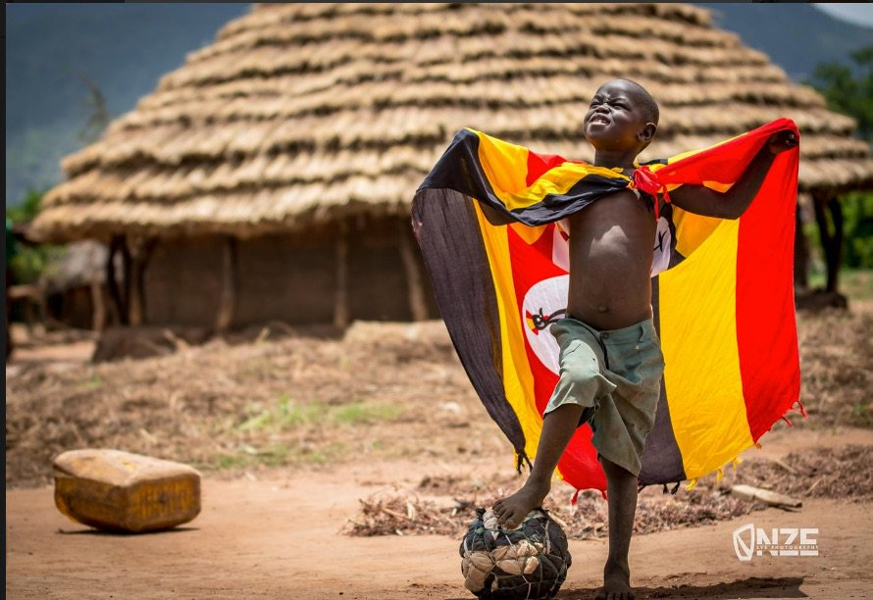
The End
oyegeivan@gmail.com
www.busitema.ac.ug

